Slide 1




TITLE PAGE
•Problem Statement Title –AI Powered Student Assistance for Technical Education
•Theme -Education
•Team ID –GNAMAS20
•Team Name (Registered on Website) -Masterminds
•Participant Names –N.GnanaSathwik
S.Jashnavi
T.Rishitha
V.Akhila
Sri Indu College of Engg & Tech - Cyber Club, Department of Cyber Security
Page 01

Slide 2

Masterminds
IDEA TITLE
Proposed Solution:
• Reduces Academic stress overload.
Sends notifications for assignment deadlines, exam schedules, projects and also academic reminders.
Intelligence guidence is provided to learn more about their perspective.
Recommends curated videos, e-books, and online courses based on the student’s academic profile.
24/7 accessibility for the site.
Sri Indu College of Engg & Tech - Cyber Club, Department of Cyber Security
Page 02

Slide 3
TECHNICAL APPROACH
Masterminds
• Frontend : HTML/Javascript.
Backend : Python/Django.
Sri Indu College of Engg & Tech - Cyber Club, Department of Cyber Security
Page 03

Slide 4
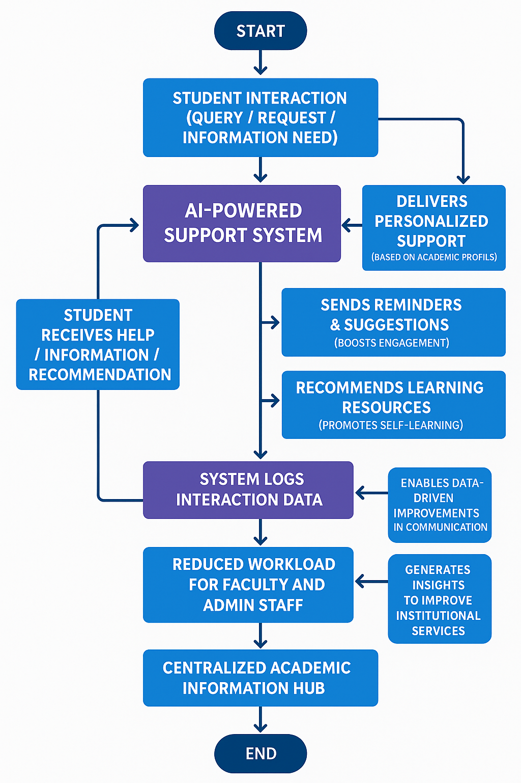
Block Diagram
Sri Indu College of Engg & Tech - Cyber Club, Department of Cyber Security

Slide 5
FEASIBILITY AND VIABILITY
Masterminds
FeasibilityUses existing AI tools (e.g., OpenAI, Dialogflow, Rasa).
Easily integrates with student portals and systems.
Supports platforms like web, mobile, WhatsApp, etc.
Ensures data privacy and security with standard protocols.
Viability Meets growing demand for EdTech and digital student support.
Offers 24/7 help, improving student satisfaction and access.
Reduces workload on faculty and administrative staff.
Low development cost; scalable with cloud-based tools.
Long-term sustainability through user feedback and updates.
Sri Indu College of Engg & Tech - Cyber Club, Department of Cyber Security
Page 04

Slide 6
IMPACT AND BENEFITS
Masterminds
• Reduces workload on academic staff and help desks.
Offers 24/7 support and guidance.
Enables data-driven improvements in academic communication.
Instant answers to student queries anytime.
Personalized support based on academic profile.
Improved engagement through reminders and suggestions.
Reduced workload for faculty and admin staff.
Centralized information hub for academic updates.
Encourages self-learning with resource recommendations.
Data insights to improve institutional services.
Sri Indu College of Engg & Tech - Cyber Club, Department of Cyber Security
Page 05

Slide 7
RESEARCH AND REFERENCES
Masterminds
Chatgpt.
Diagramgpt.
Open AI.
Sri Indu College of Engg & Tech - Cyber Club, Department of Cyber Security
Page 06

Slide 8
Masterminds
FUTURE ENHANCEMENTS
Voice Assistant Integration – Add support for voice queries via Alexa, Google Assistant, etc..
Student Emotion Detection – Analyze tone or sentiment to offer emotional or mental health support.
Gamification – Introduce quizzes, badges, and progress tracking to boost motivation.
Sri Indu College of Engg & Tech - Cyber Club, Department of Cyber Security
Page 07

Slide 9
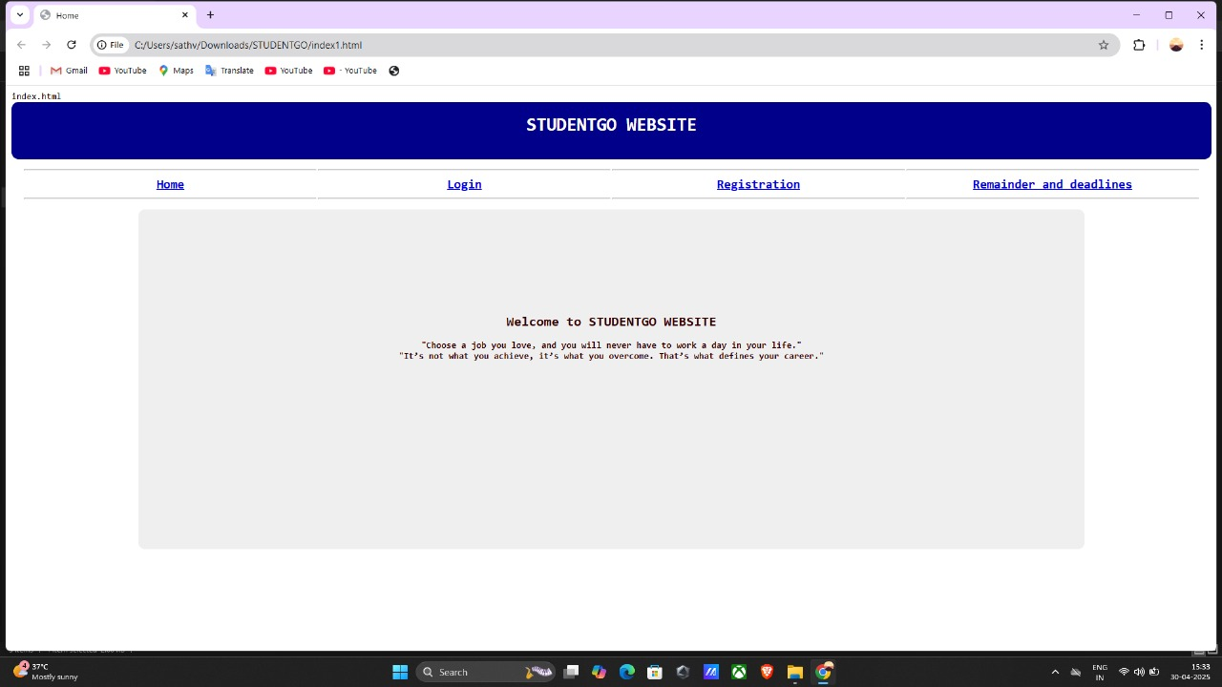
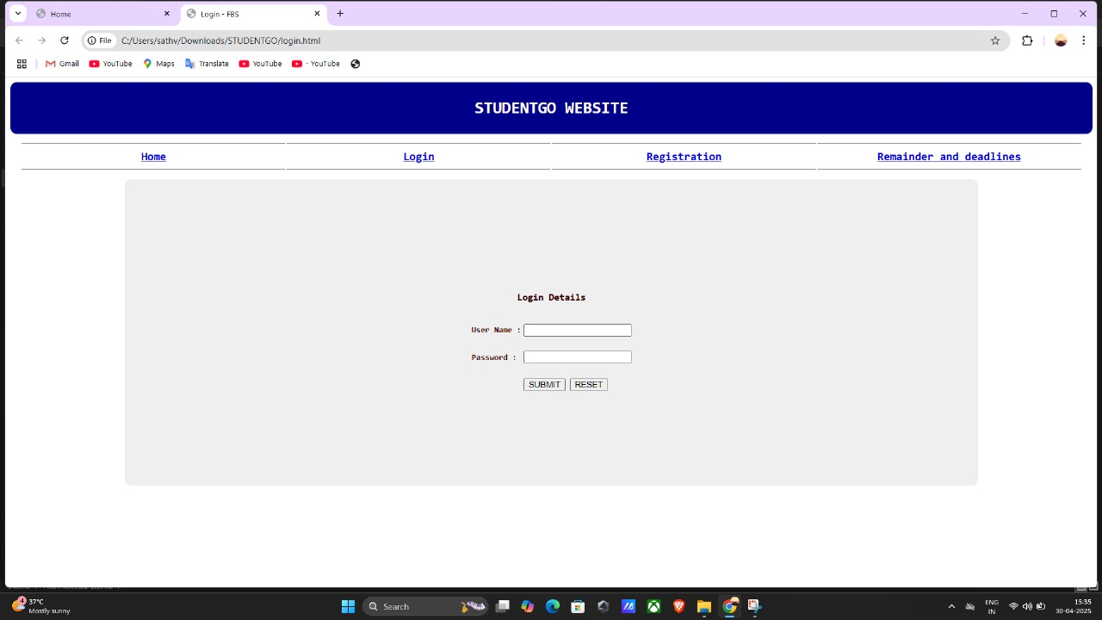
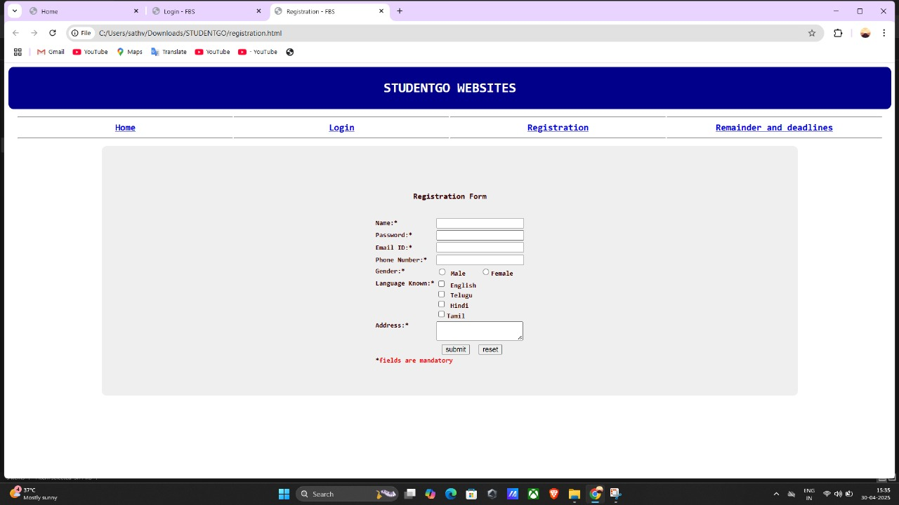
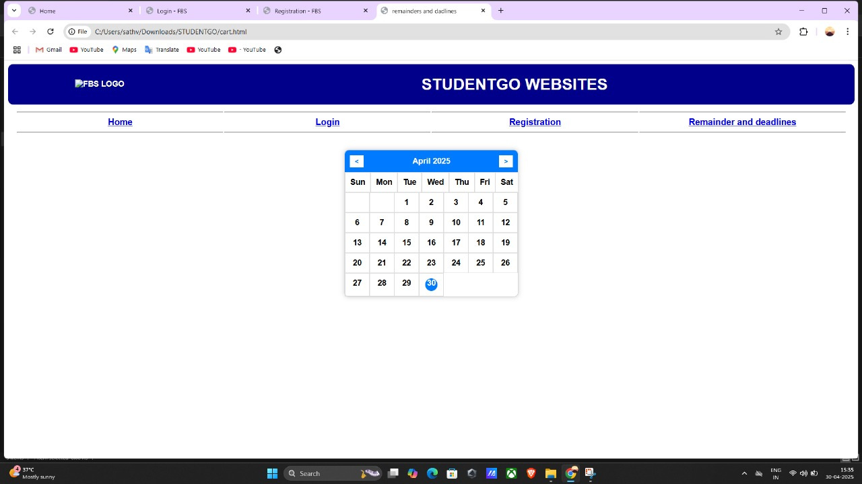
DEMO (IF APPLICABLE)
Masterminds
Sri Indu College of Engg & Tech - Cyber Club, Department of Cyber Security
Page 08

Slide 10
Masterminds
CONCLUSION & THANK YOU
The chatbot is technically feasible using current AI tools and platforms.
It is viable in the education market due to high demand for digital support.
Improves student experience through instant, accurate assistance.
Reduces staff workload by automating common queries.
Cost-effective and scalable, especially with phased development.
Offers long-term sustainability through regular updates and learning.
THANK YOU
Sri Indu College of Engg & Tech - Cyber Club, Department of Cyber Security
Page 09

